Slide 1

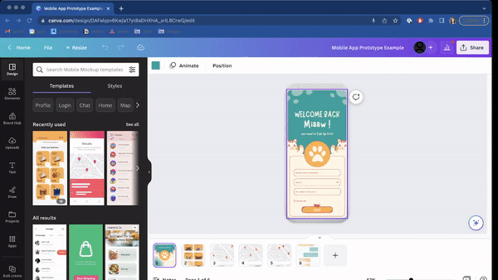
Prototyping with Canva.com
Canva.com provides an easy-to-use, drag-and-drop interface for creating your mobile app design. There are hundreds of templates which make it easy to get started on your design!

Slide 2

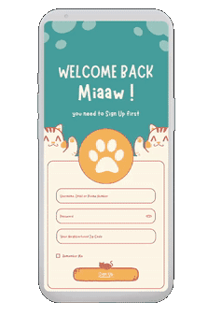
 | Design Goals You final app design should include at least four screens: Screen #1: Onboarding Screen #2: Sign Up Screen #3: Dashboard Screen #4: Feature Need more screens? Add as many as you need to demonstrate your idea!

Slide 3
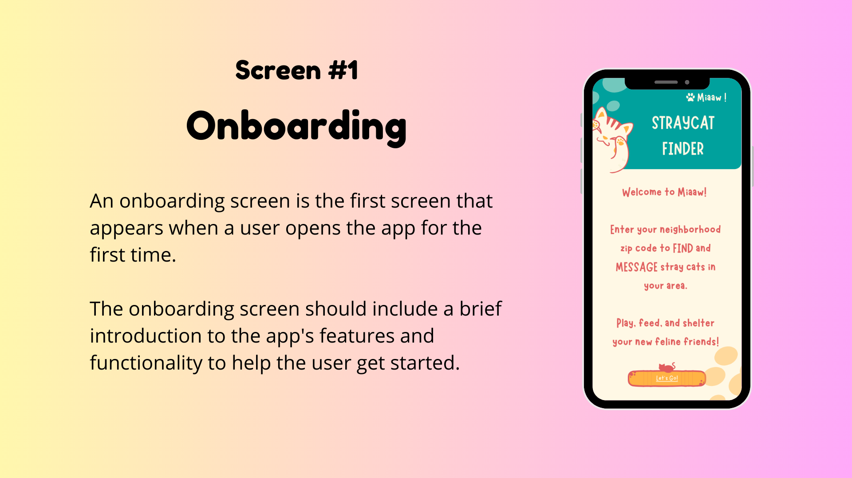

Slide 4
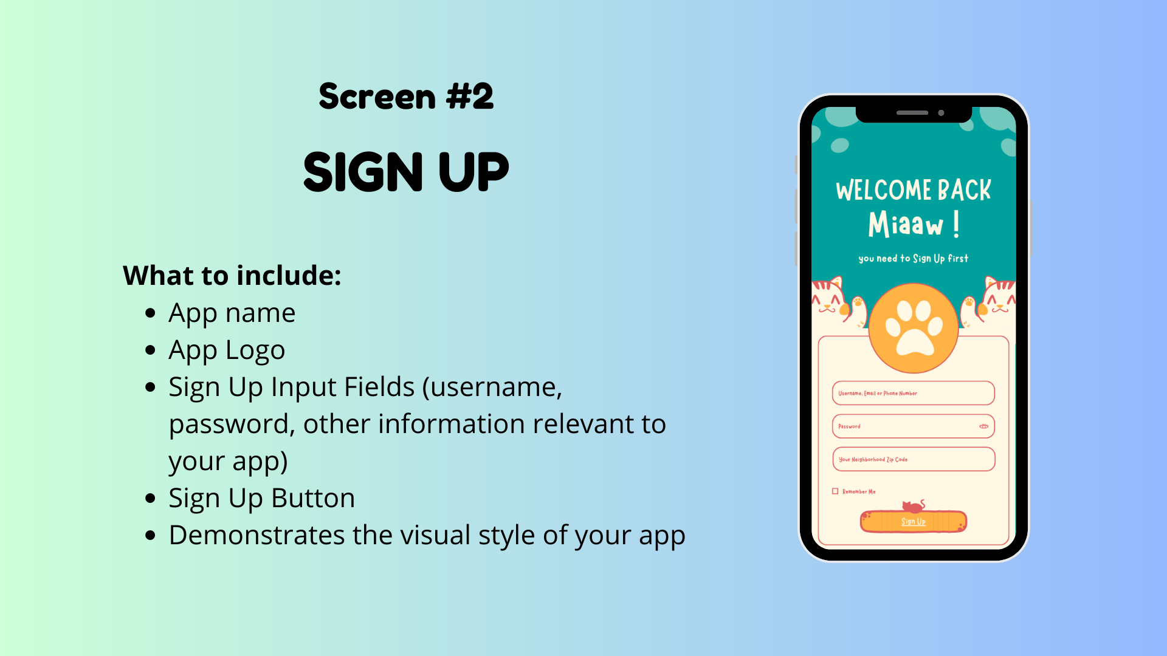

Slide 5
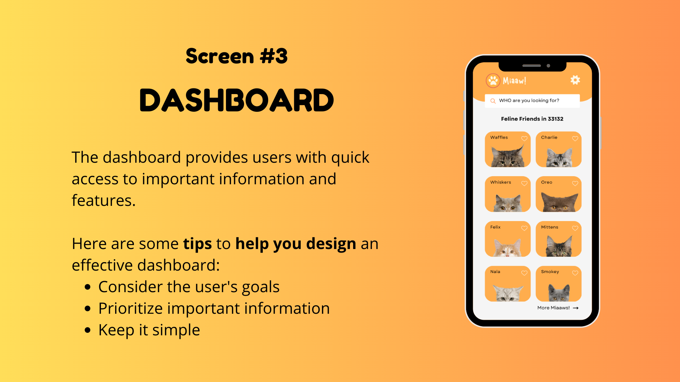

Slide 6
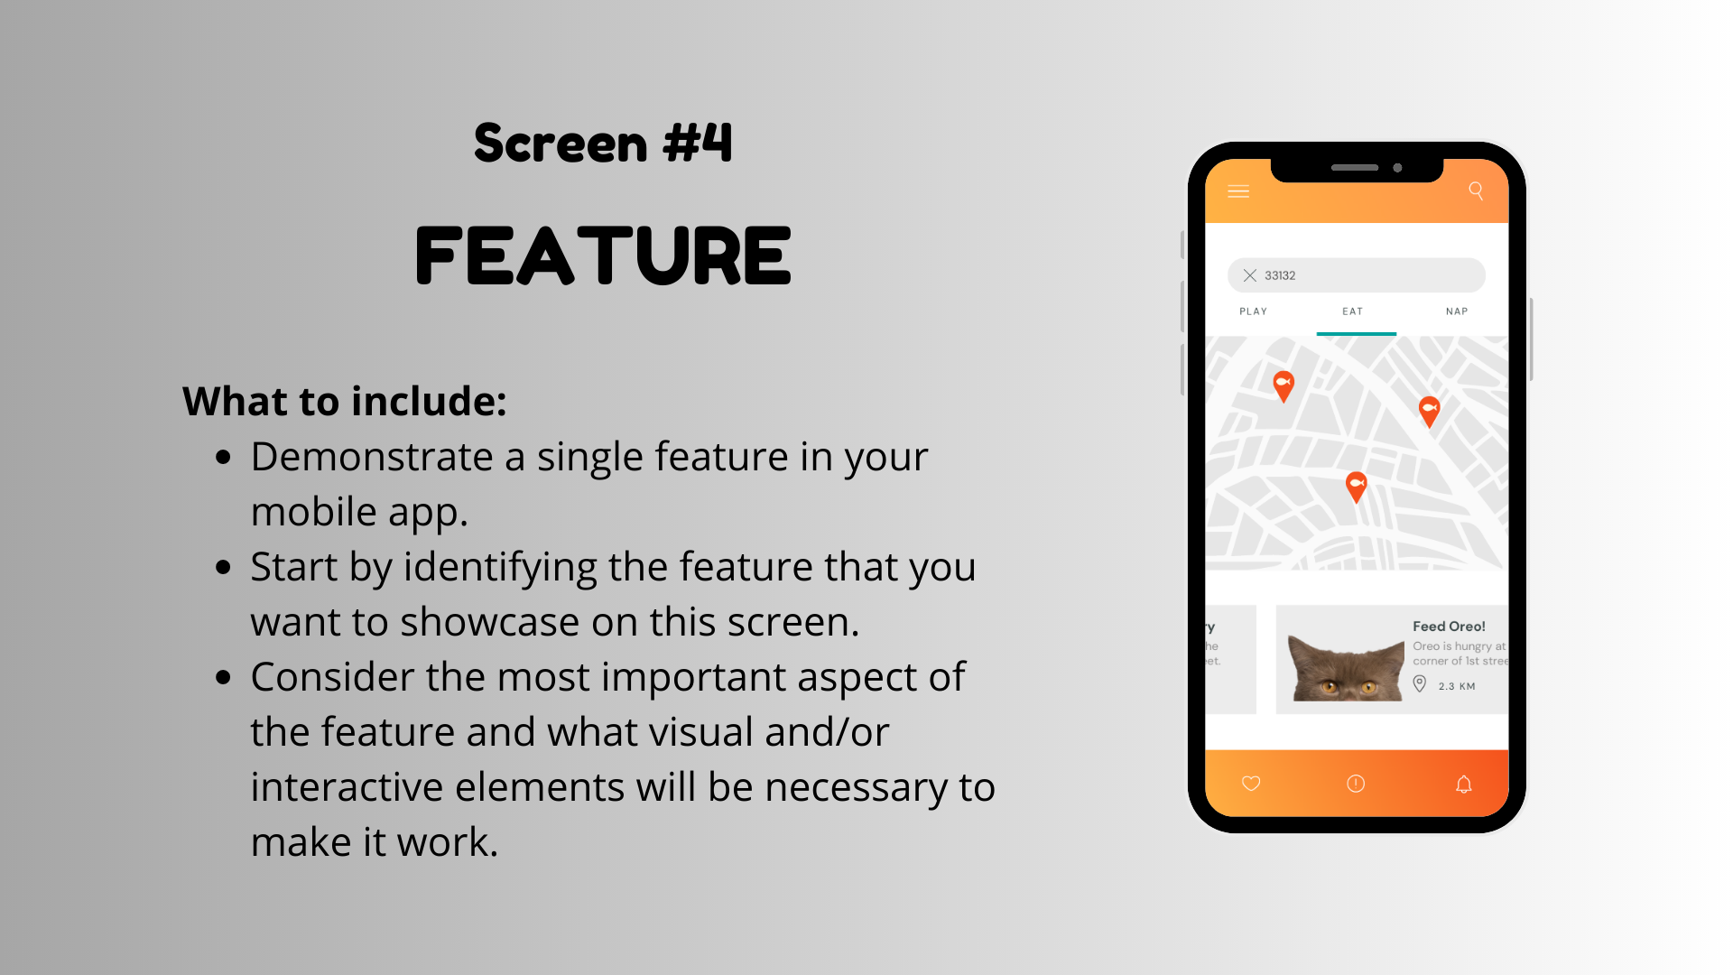

Slide 7
